Slide 1


Understanding RowHammer Under Reduced Wordline Voltage An Experimental Study Using Real DRAM Devices
Abdullah Giray Yağlıkçı
Haocong Luo Geraldo F. de Oliviera Ataberk Olgun
Minesh Patel Jisung Park Hasan Hassan Jeremie S. Kim
Lois Orosa Onur Mutlu
Notes:
Hello, I am Giray, and I will present our new paper Understanding RowHammer Under Reduced Wordline Voltage

Slide 2
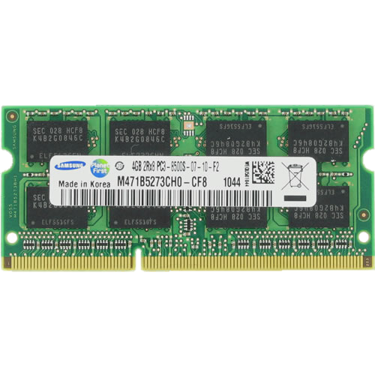
DRAM Organization
Subarray
Bitline
DRAM Cell
Bank
Wordline
Chip I/O
. . .
…
DRAM Row
…
…
…
…
…
Row Buffer
DRAM Chip
DRAM Bank
DRAM Subarray
Notes:
This is a DRAM module, used as the main memory in many computing systems. [CLICK]
A DRAM module consists of multiple chips each of which contains multiple banks [CLICK]
Each bank is composed of multiple subarrays [CLICK]
And within each subarray, there is a two dimensional array of DRAM cells. [CLICK]
These cells are organized into rows that are selected using wordlines [CLICK]
And the cells are connected to a row buffer via bitlines [CLICK]

Slide 3
DRAM Organization and Operation
Bitline
DRAM Cell
Wordline
VPP (2.5V)
Wordline
Access transistor
…
VDD
(1.2V)
DRAM Subarray
…
DRAM Cell
charge
leakage
paths
Capacitor
Bitline
…
…
…
…
Row Buffer
I/O Circuitry
Refresh: Restores the capacitor voltage with a time period called refresh window
Row Activation: Fetch the row’s content into the row buffer
Column Access: Read/Write a column in the row buffer
Precharge: Disconnect the row from the row buffer
Notes:
This is a simplified diagram of a DRAM cell, where the data is stored as capacitor voltage, and accessed through the access transistor [CLICK]
The cell charge is driven by using a nominal supply voltage of 1.2V denoted as VDD [CLICK]
A DRAM cell inherently exhibits several charge leakage paths [CLICK]
And requires to perform refresh operations to restore the capacitor voltage with a time period called refresh window.
[PAUSE]
To access a DRAM cell, [CLICK]
the memory controller must first open or activate the row to fetch the row’s data into the row buffer [CLICK]
A row is activated by asserting its wordline using a nominal wordline voltage of 2.5V, denoted as VPP [CLICK]
The READ and WRITE requests targeting the row are serviced from the row buffer [CLICK]
After all requests are serviced from the row, the memory controller must close or precharge the row in order to begin accessing data from another row. [CLICK]

Slide 4
The RowHammer Vulnerability
DRAM Subarray
Row 0
Row 0
Victim Row
Row 1
Row 1
Row 1
Victim Row
open (high voltage)
open (high voltage)
open (high voltage)
closed (low voltage)
closed (low voltage)
Row 2
Row 2
Row 2
Row 2
Row 2
Row 2
Aggressor Row
Row 3
Row 3
Row 3
Aggressor Row
Victim Row
Row 2
closed
Row 4
Row 4
Victim Row
Repeatedly opening (activating) and closing (precharging)
a DRAM row in real DRAM chips causes RowHammer bit flips in nearby cells
Notes:
Due to an increase in cell-to-cell interference, as a result of aggressive technology node scaling in real DRAM chips, repeatedly activating [CLICK] and precharging
[FORTH & BACK] a DRAM row can result in bit flips in physically adjacent rows [CLICK]
[FORTH & BACK] Continuing to access the same row results in even more failures in nearby rows. This phenomenon is known as RowHammer. [CLICK]
We refer to the rapidly accessed row as an aggressor row and the rows containing bit flips as victim rows.

Slide 5
A Closer Look into RowHammer
Low Voltage
Victim Row
Agressor Row
Wordline Voltage
Low Voltage
Victim Row
time
Repeatedly toggling
wordline voltage
is the key to inducing RowHammer bit flips
Aggressor Row
Low Voltage
Aggressor Row
Disturbance
High Voltage
Low Voltage
Victim Row
Low Voltage
Victim Row
Bitline
Notes:
This cartoon provides a closer look into RowHammer. [CLICK]
Asserting high voltage to a row’s wordline for row activation disturbs nearby rows [CLICK]
Repeating this operation [CLICK] many times [CLICK] exacerbates the leakage in victim rows and leads to bit flips [CLICK]
Therefore, repeatedly toggling wordline voltage is the key to induce RowHammer bit flips [CLICK]

Slide 6
Executive Summary
Motivation:
Repeatedly toggling a DRAM row’s wordline voltage causes bit flips in nearby rows
This vulnerability, RowHammer, worsens in denser DRAM chips
Understanding RowHammer enables designing effective and efficient solutions
Problem: No study demonstrates how wordline voltage (VPP) affects RowHammer
Goal: Experimentally understand how VPP affects RowHammer and DRAM operation
Experimental study: 272 DRAM chips from three major DRAM manufacturers
VPP’s effect on RowHammer: Six observations show that with reduced VPP,
Bit error rate caused by a RowHammer attack reduces by 15.2% (66.9% max)
A row needs to be activated 7.4% more times (85.8% max) to induce the first bit flip
VPP’s effect on DRAM operation: Nine observations show that with reduced VPP,
208 out of 272 tested DRAM chips reliably operate using nominal timing parameters
Erroneous DRAM chips can reliably operate with
A longer row activation latency, i.e., 24ns/15ns for 48/16 chips,
Single-error-correcting codes or 2x the refresh rate only for 16.4% of rows
Conclusion: Reducing wordline voltage can reduce RowHammer vulnerability without significantly affecting reliable DRAM operation
Notes:
With this background, I will quickly summarize our work [CLICK]
Repeatedly toggling a DRAM row’s wordline voltage causes bit flips in nearby rows, breaking the memory isolation. [CLICK]
This vulnerability, called RowHammer, worsens in denser DRAM chips [CLICK]
And Understanding RowHammer is critical to find effective and efficient solutions. [CLICK]
However, no prior study demonstrates how this vulnerability varies with wordline voltage: VPP[CLICK]
In this work, our goal is to experimentally understand how VPP affects RowHammer and reliable DRAM operation [CLICK]
To this end, we test 272 real DDR4 DRAM chips from three major manufacturers [CLICK]
Based on our analyses, we make SIX observations showing a reduction in RowHammer vulnerability by scaling down VPP such that[CLICK]
bit error rate due to a RowHammer attack significantly reduces [CLICK]
And inducing a bit flip requires larger activation counts [CLICK]
To evaluate VPP's effect on reliable DRAM operation, we make NINE observations showing that [CLICK]
Most of the tested DRAM chips reliably operate at reduced VPP using nominal timing parameters [CLICK]
And the erroneous DRAM chips can still reliably operate with [CLICK]
a longer row activation latency [CLICK]
And when used with a SIMPLE single error correcting code or double the refresh rate for a small fraction of DRAM rows [CLICK]
Based on our findings, we conclude that scaling down the wordline voltage can reduce RowHammer vulnerability without significantly affecting reliable DRAM operation [END]

Slide 7
Outline
Motivation and Goal
Motivation and Goal
Experimental Methodology
Temperature Analysis
Aggressor Row Active Time Analysis
Spatial Variation Analysis
Implications on Attacks and Defenses
Conclusions
Experimental Methodology
RowHammer Under Reduced Wordline Voltage
DRAM Operation Under Reduced Wordline Voltage
Conclusions
Notes:
This is the outline of the talk.

Slide 8
Outline
Motivation and Goal
Motivation and Goal
Experimental Methodology
Temperature Analysis
Aggressor Row Active Time Analysis
Spatial Variation Analysis
Implications on Attacks and Defenses
Conclusions
Experimental Methodology
RowHammer Under Reduced Wordline Voltage
DRAM Operation Under Reduced Wordline Voltage
Conclusions
Notes:
Let me motivate our work

Slide 9
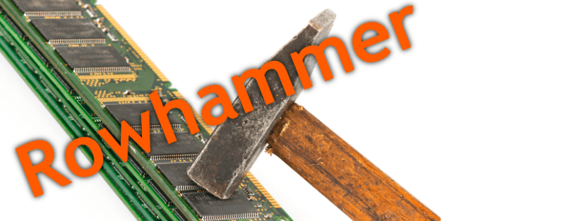

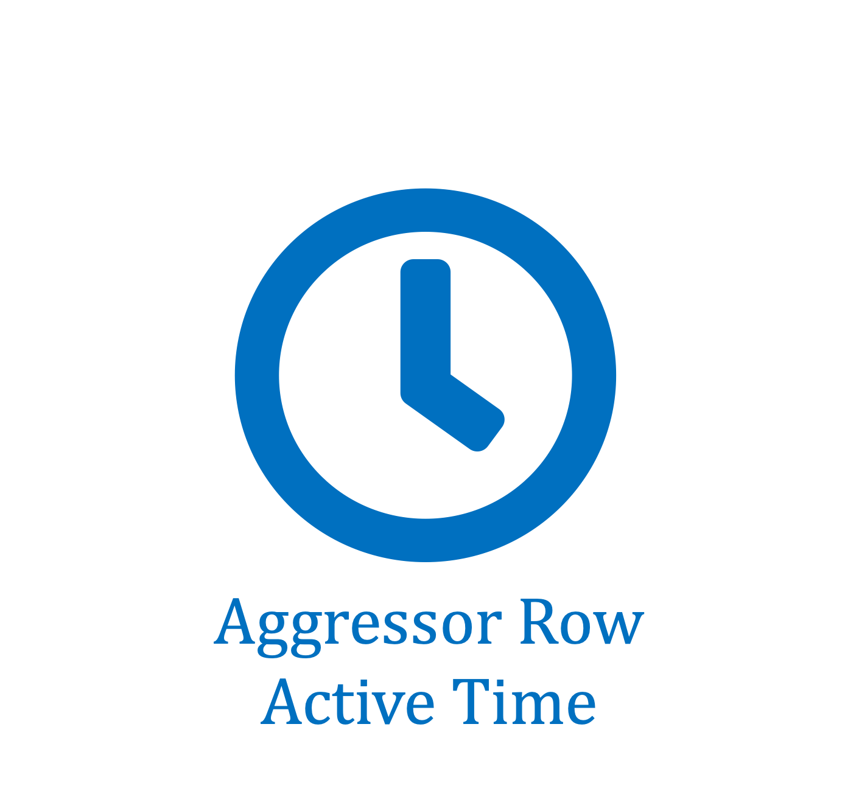

Motivation
2020
More than 10X reduction
Manufactured Year
2014
Minimum Activation Count to Observe a Bit Flip [Kim+, ISCA’20]
Defenses are becoming prohibitively expensive [Kim et al., ISCA’20]
A deeper understanding is needed [Orosa and Yaglikci et al., MICRO’21]
Prior works investigate how RowHammer changes across
DDR3
Technology
Scaling
DDR4
LPDDR4
[Kim et al., ISCA’20]
[Orosa and Yaglikci et al., MICRO’21]
Repeatedly toggling wordline voltage causes RowHammer
No rigorous experimental study demonstrates how the magnitude of wordline voltage affects the RowHammer vulnerability of real DRAM chips
Notes:
RowHammer is a DRAM reliability and security problem [CLICK]
Denser DRAM chips are significantly more vulnerable to RowHammer, such that [CLICK]
the minimum activation count to observe a bit flip has reduced by more than an order of magnitude in less than a decade [CLICK]
Recent works have demostrated that many defense mechanisms are becoming prohibitively expensive for future DRAM chips [CLICK]
A deeper understanding of RowHammer is the key to overcome this challenge [CLICK]
Prior works already study how RowHammer changes across [CLICK]
Different DRAM standards [CLICK]
Generations [CLICK]
Temperature levels [CLICK]
Aggressor row’s active time [CLICK]
And Victim DRAM cell’s physical location [CLICK]
Unfortunately, a fundamental piece is missing: [CLICK]
RowHammer is caused by repeatedly toggling the wordline voltage [CLICK]
However, no rigorous experimental study demonstrates how the magnitude of the wordline voltage affects RowHammer [CLICK]

Slide 10
Our Hypothesis
Reducing wordline voltage
can reduce RowHammer vulnerability
without significantly affecting reliable DRAM operation
Wordline
Voltage
Wordline
Voltage
time
time
Aggressor Row
Aggressor Row
Victim Row
Reduction in Disturbance
Victim Row
Bitline
Bitline
Wordline
Wordline
Weaker Channel in Access Transistor
Strong Channel
Weaker Channel
Notes:
In this work, we hypothesize that [CLICK]
Lowering the magnitude of wordline voltage [CLICK]
can reduce RowHammer vulnerability [CLICK]
without significantly affecting reliable DRAM operation [END]

Slide 11
Our Goal
Understand how the wordline voltage (VPP) affects
RowHammer vulnerability
and reliable DRAM operation on real DRAM chips
Bitline
DRAM Cell
Wordline
…
DRAM Subarray
…
…
…
…
…
Row Buffer
I/O Circuitry
Notes:
And our goal is to understand how the Wordline Voltage affects [CLICK]
RowHammer vulnerability [CLICK]
and reliable DRAM operation on real DRAM chips [CLICK]

Slide 12
Outline
Motivation and Goal
Motivation and Goal
Experimental Methodology
Temperature Analysis
Aggressor Row Active Time Analysis
Spatial Variation Analysis
Implications on Attacks and Defenses
Conclusions
Experimental Methodology
RowHammer Under Reduced Wordline Voltage
DRAM Operation Under Reduced Wordline Voltage
Conclusions
Notes:
Now I will explain our experimental methodology

Slide 13
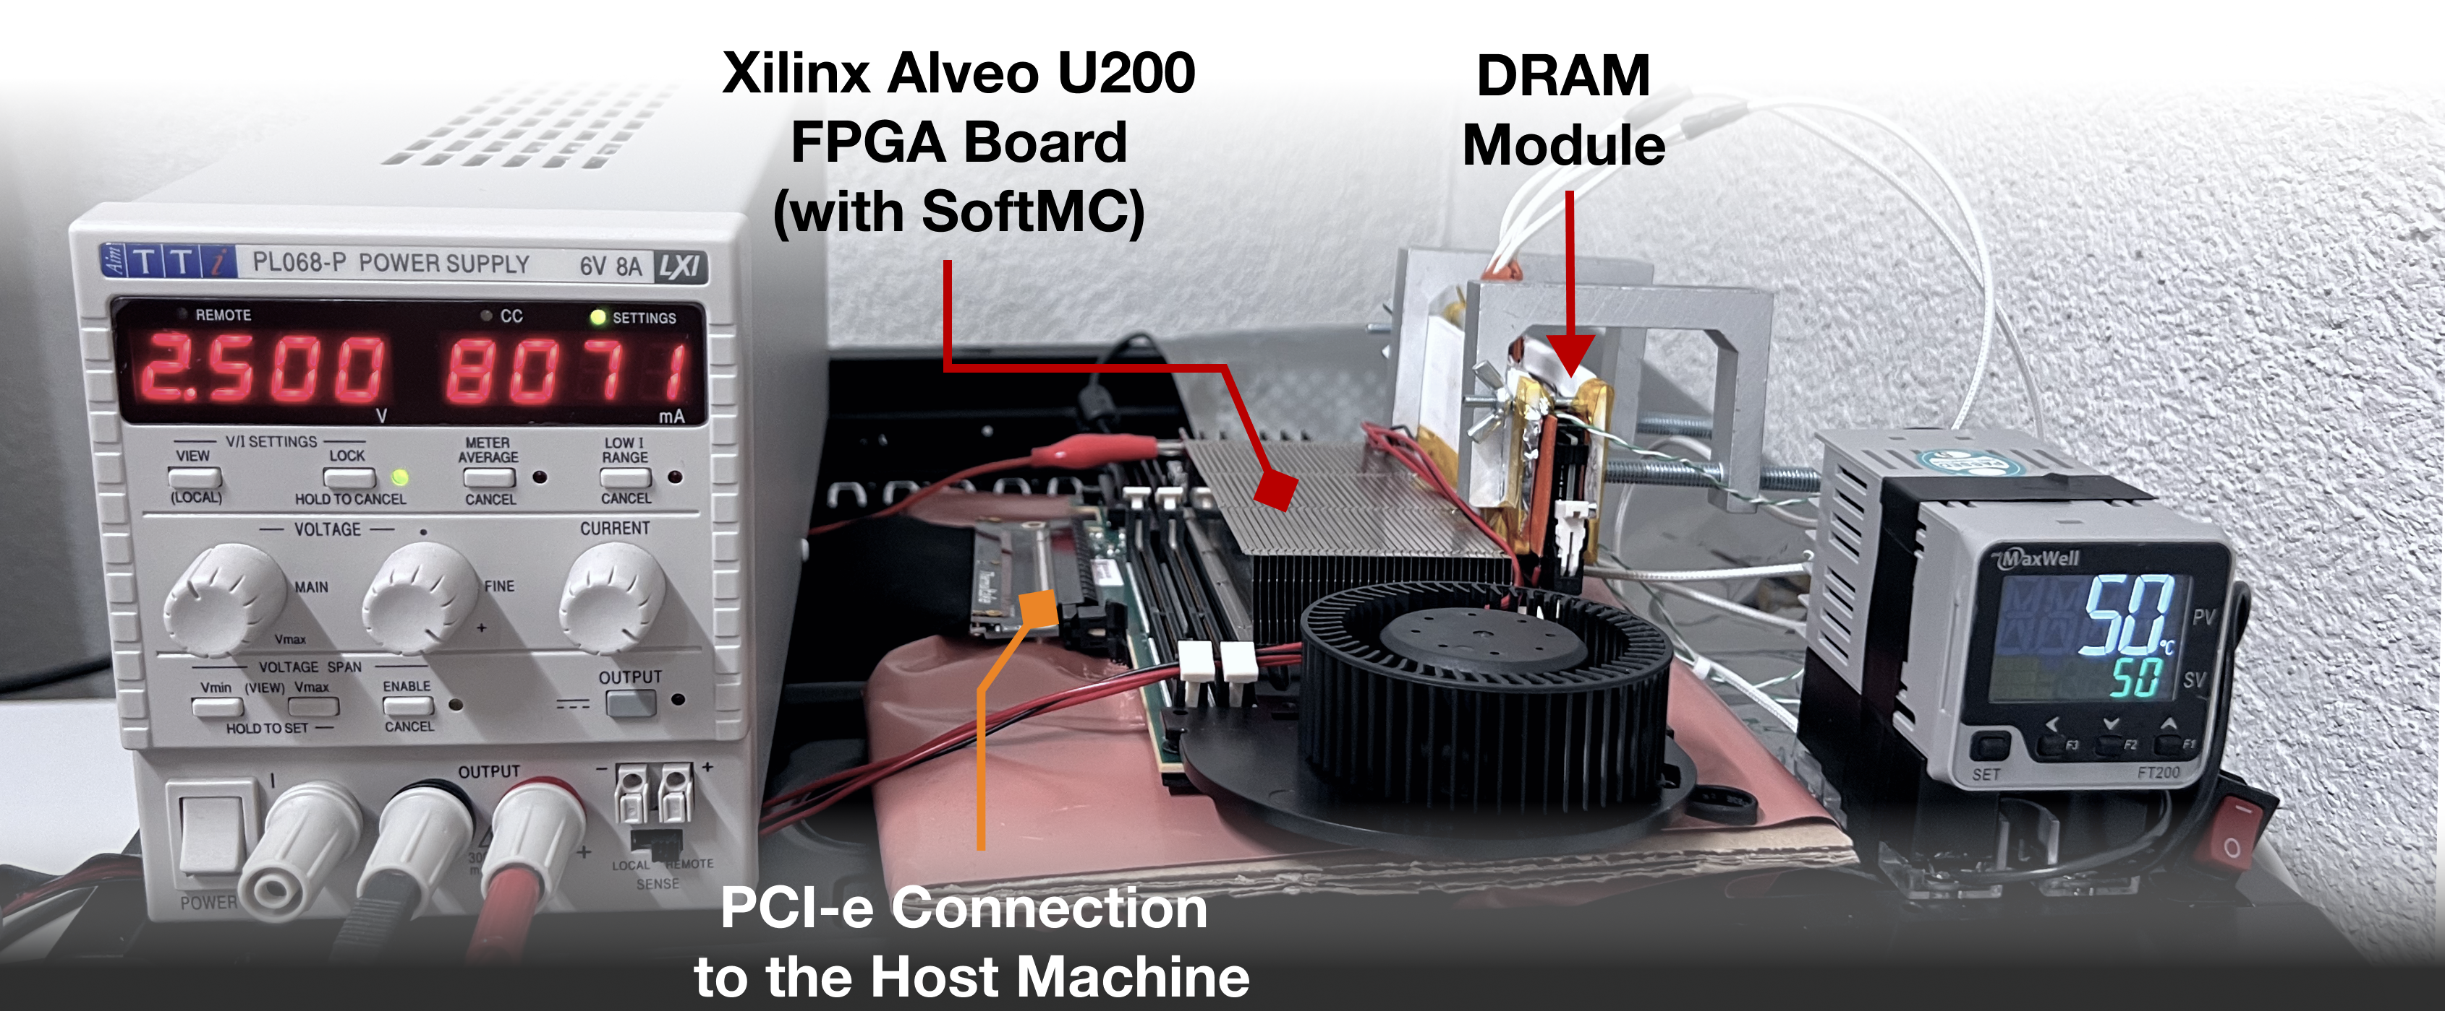
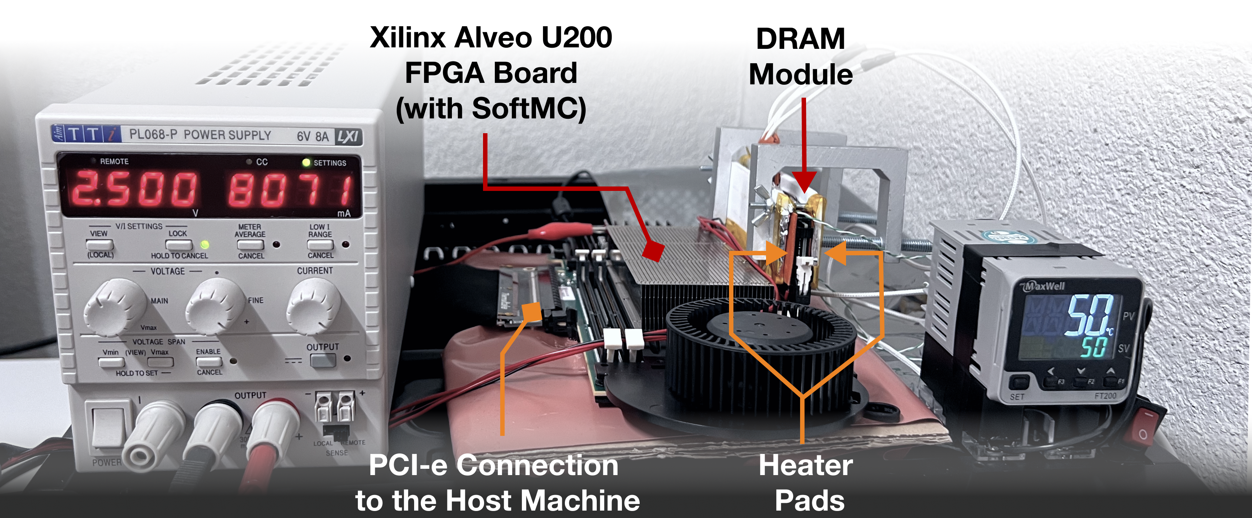
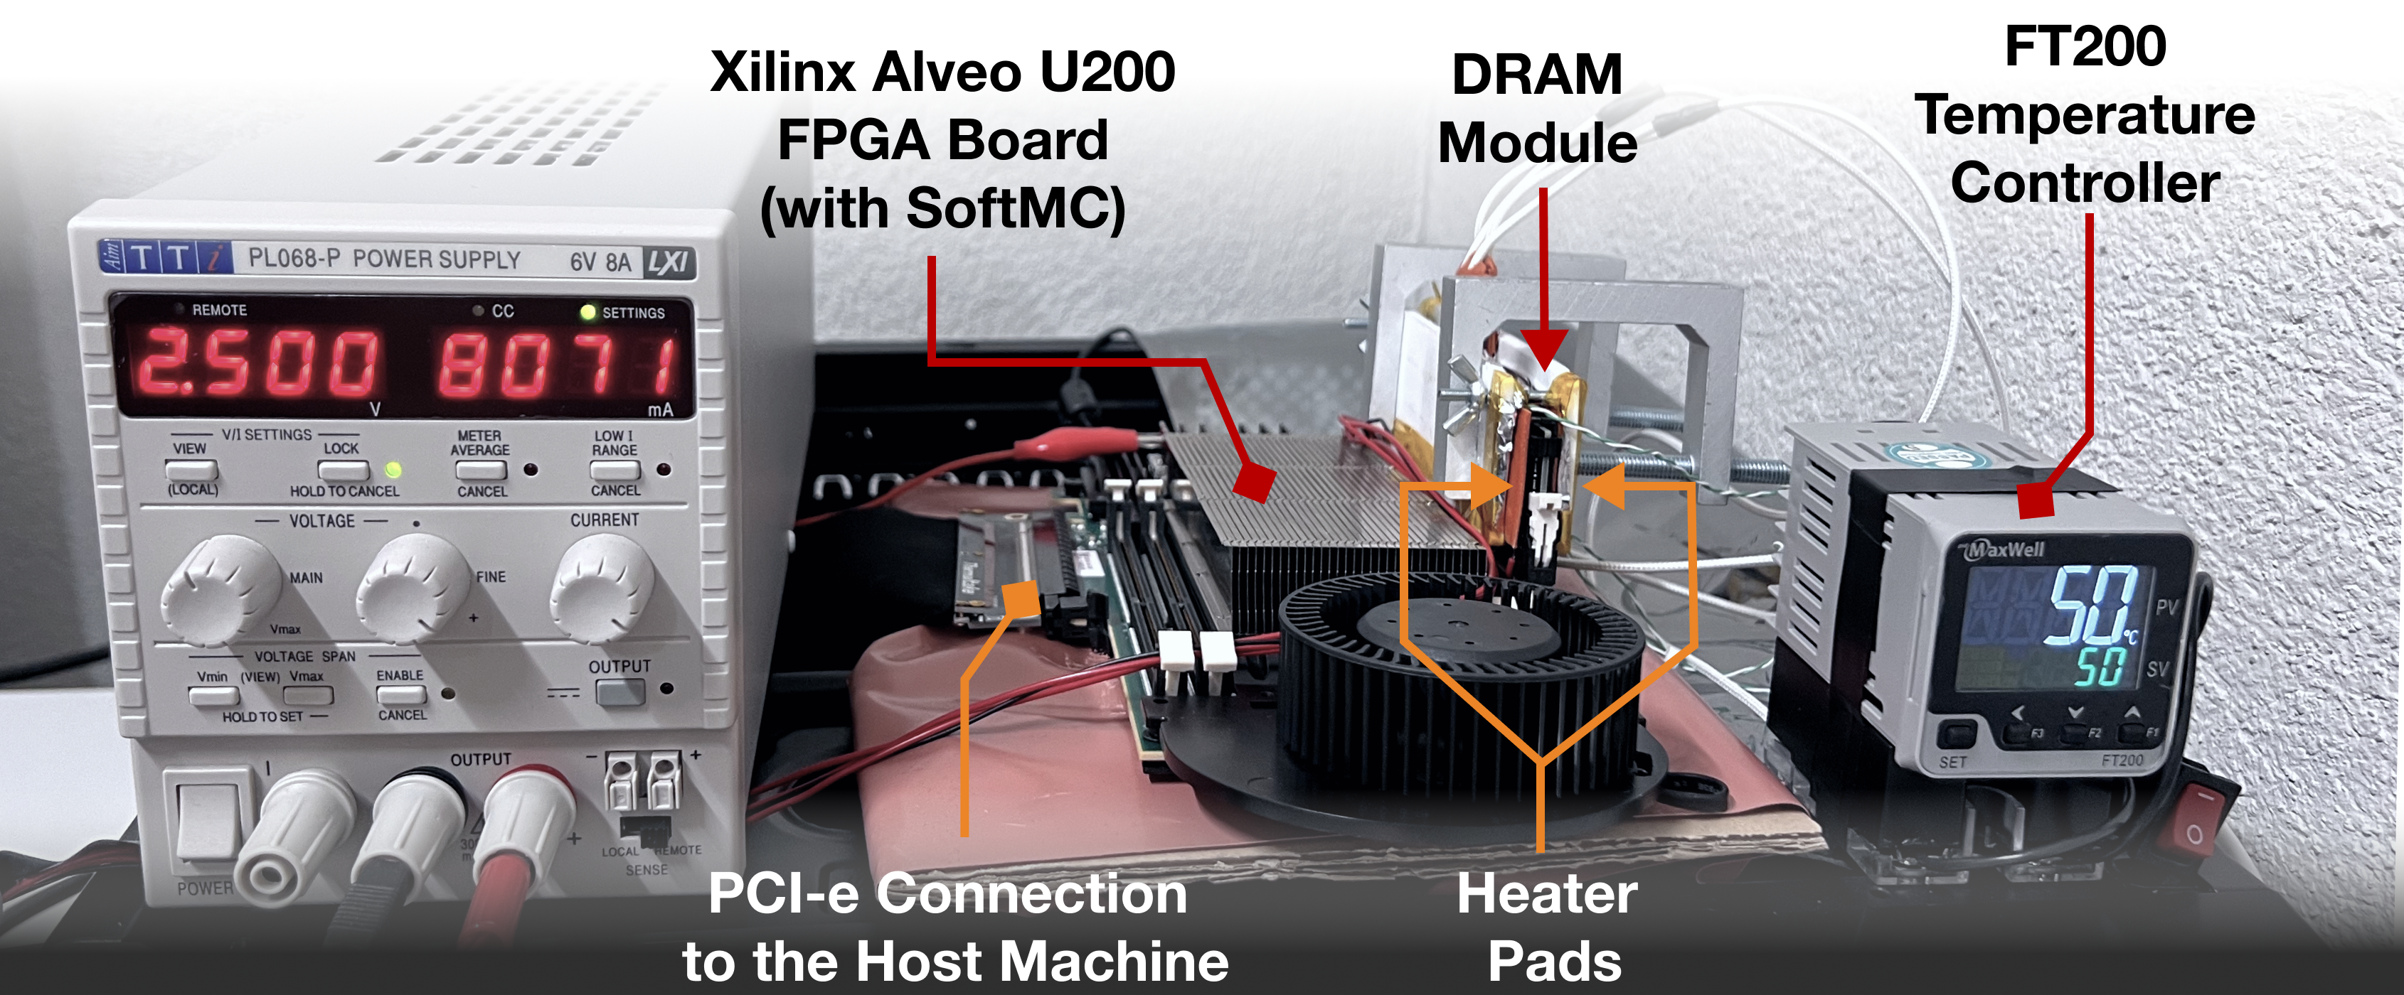
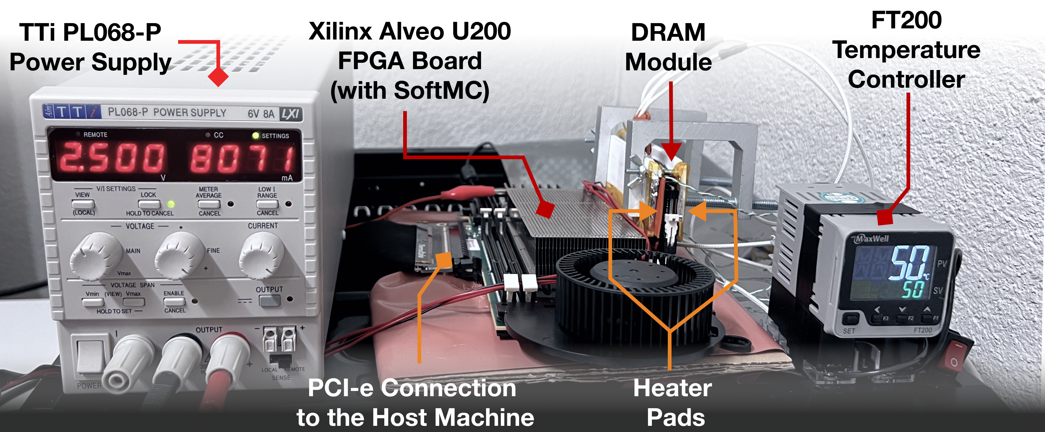
DRAM Testing Infrastructure
FPGA-based SoftMC (Xilinx Virtex UltraScale+ XCU200)
*
Fine-grained control over DRAM commands,
timing parameters (±1.5ns), temperature (±0.1°C ),
and wordline voltage (±1mV)
*Hassan et al., "SoftMC: A Flexible and Practical Open-Source Infrastructure for Enabling Experimental DRAM Studies," in HPCA, 2017. [Available on GitHub: https://github.com/CMU-SAFARI/SoftMC]
Notes:
We use an FPGA-based experimental setup programmed with a modified version of SoftMC [CLICK]
We control the chip temperature using a pair of heaters [CLICK] connected to a temperature controller [CLICK]
We supply the wordline voltage using the VPP power rail from an external power supply [CLICK]
This infrastructure provides fine-grained control over DRAM commands, timing parameters, temperature, and wordline voltage [CLICK]
=======

Slide 14
DRAM Testing Methodology
To characterize our DRAM chips at worst-case conditions:
Prevent sources of interference during core test loop
No DRAM refresh: to avoid refreshing victim row
No DRAM calibration events: to minimize variation in test timing
No RowHammer mitigation mechanisms: to observe circuit-level effects
Test for less than a refresh window (32ms) to avoid retention failures
Repeat tests for ten times
Worst-case access sequence
We use worst-case access sequence based on prior works’ observations
For each row, repeatedly access the two physically-adjacent rows as fast as possible
Notes:
To characterize our DRAM chips at worst-case conditions we take two measures:
[CLICK] First, we prevent external sources of interference such that our tests can run consistently as desired and without interruptions. To achieve this we disable:
[CLICK] DRAM refresh to avoid refreshing victim rows during a test,
[CLICK] DRAM calibration events to minimize variation in test timings
[CLICK] and RowHammer mitigation mechanisms to ensure that we can directly observe circuit-level bit flips
[CLICK] we also ensure that our RowHammer tests complete in less than a refresh window to prevent retention failures from interfering with our results
[CLICK] and we repeat our tests ten times to filter out the noise in measurements
[CLICK] Second, we issue the worst-case access sequence for inducing RowHammer bit flips based on observations from prior work
[CLICK] which suggest to repeatedly activate the two physically-adjacent rows as fast as possible
=========

Slide 15
DRAM Chips Tested
272 DDR4 DRAM Chips
Mfr. | # DIMMs | # Chips | Density | Die | Org. | Date
A (Micron) | 1 4 3 2 | 8 64 24 16 | 4Gb 8Gb 4Gb 4Gb | - B F - | x8 x4 x8 x8 | 48-16 11-19 07-21
B (Samsung) | 2 1 3 1 1 2 | 16 8 24 8 8 16 | 8Gb 8Gb 8Gb 4Gb 4Gb 8Gb | B C D E F | x8 x8 x8 x8 x8 x8 | 52-20 19-19 10-21 08-17 02-21
C (SK Hynix) | 2 3 2 3 | 16 24 16 24 | 16Gb 4Gb 4Gb 8Gb | A B C D | x8 x8 x8 x8 | 51-20 02-21 48-20
3 Major Manufacturers
Notes:
In our characterization, [CLICK]
we test 272 real DRAM chips [CLICK]
from three major manufacturers, [CLICK]
that implement different densities, die revisions, and chip organizations[CLICK]

Slide 16
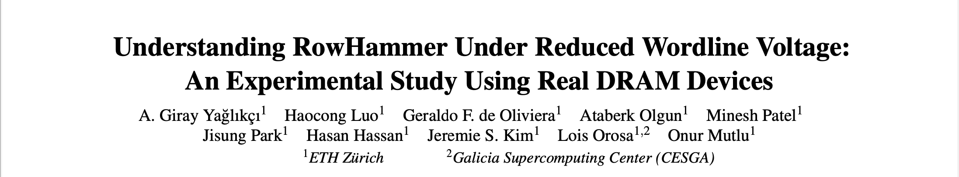
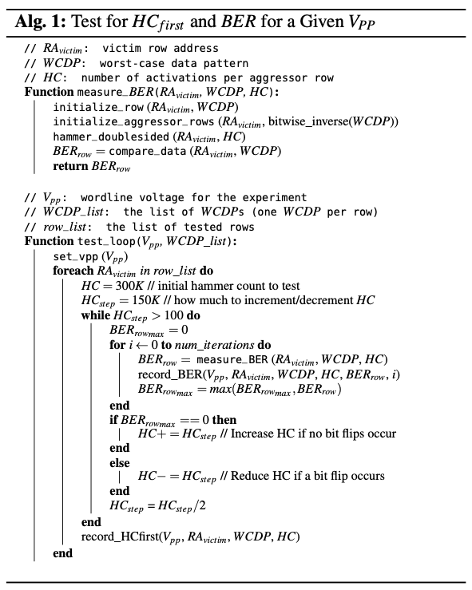
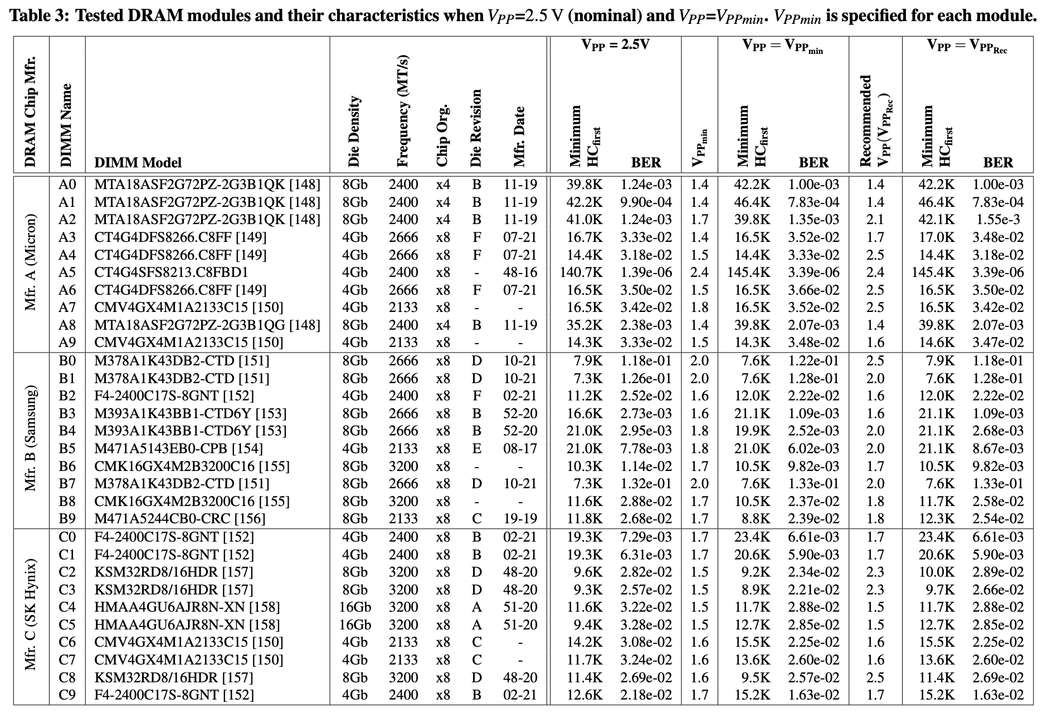
More Details in the Paper
272 DDR4 DRAM Chips
Mfr. | # DIMMs | # Chips | Density | Die | Org. | Date
A (Micron) | 1 4 3 2 | 8 64 24 16 | 4Gb 8Gb 4Gb 4Gb | - B F - | x8 x4 x8 x8 | 48-16 11-19 07-21
B (Samsung) | 2 1 3 1 1 2 | 16 8 24 8 8 16 | 8Gb 8Gb 8Gb 4Gb 4Gb 8Gb | B C D E F | x8 x8 x8 x8 x8 x8 | 52-20 19-19 10-21 08-17 02-21
C (SK Hynix) | 2 3 2 3 | 16 24 16 24 | 16Gb 4Gb 4Gb 8Gb | A B C D | x8 x8 x8 x8 | 51-20 02-21 48-20
3 Major Manufacturers
Full paper on arXiv: https://arxiv.org/abs/2206.09999
Notes:
The full paper provides for more detailed information about both the algorithms for each of our experiments and the chips that we test

Slide 17
Outline
Motivation and Goal
Motivation and Goal
Experimental Methodology
Temperature Analysis
Aggressor Row Active Time Analysis
Spatial Variation Analysis
Implications on Attacks and Defenses
Conclusions
Experimental Methodology
RowHammer Under Reduced Wordline Voltage
DRAM Operation Under Reduced Wordline Voltage
Conclusions
Notes:
Now I will share our observations on RowHammer under reduced wordline voltage

Slide 18
Key Takeaway from RowHammer Analysis
Takeaway 1
Reducing wordline voltage reduces RowHammer vulnerability
15.2% (66.9% max) fewer bit flips occur
Activation count at which the first bit flip occurs increases by 7.4% (85.8% max)
Notes:
We summarize our findings as scaling down wordline voltage leads to fewer DRAM cells to experience a RowHammer bit flip,
and bit flips to occur at larger hammer counts

Slide 19
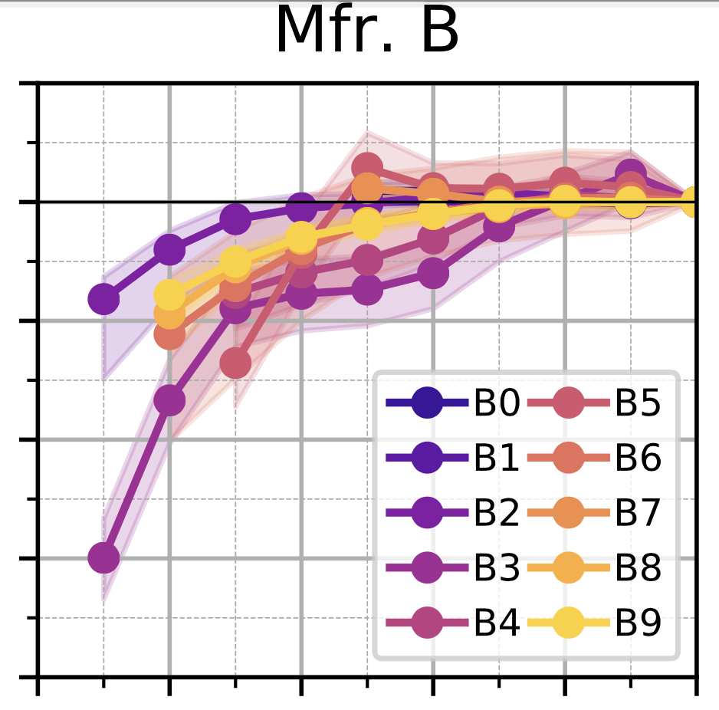
Wordline Voltage’s Effect on RowHammer
1.2
1.0
0.8
0.6
0.4
0.2
1.2
1.0
0.8
0.6
0.4
0.2
BER reduces as VPP reduces
Bit Error Rate
(Normalized to VPP=2.5V)
Lower is better
Different DRAM modules
Variation across DRAM rows
1.5 1.7 1.9 2.1 2.3 2.5
1.5 1.7 1.9 2.1 2.3 2.5
Wordline Voltage: VPP (V)
Wordline Voltage: VPP (V)
OBSERVATION 1
Fewer DRAM cells experience RowHammer bit flips under reduced wordline voltage
Notes:
We begin with investigating wordline voltage’s effect on RowHammer bit error rate. This figure shows how [CLICK]
reducing wordline voltage [CLICK]
affects RowHammer bit error rate. Lower bit error rate is better for robustness [CLICK]
In this plot, each curve represents a different DRAM module [CLICK]
And the shade around each curve shows the variation across different DRAM rows [CLICK]
We observe that fewer DRAM cells experience RowHammer bit flips under reduced wordline voltage [CLICK]

Slide 20
Wordline Voltage’s Effect on RowHammer
1.2
1.0
0.8
0.6
0.4
0.2
Bit error rate increases
Bit Error Rate
(Normalized to VPP=2.5V)
Lower is better
1.5 1.7 1.9 2.1 2.3 2.5
Wordline Voltage: VPP (V)
OBSERVATION 2
Reducing wordline voltage can cause more DRAM cells to experience bit flips in a small fraction of rows (15.4%)
Notes:
In contrast to the dominant trend,
we also observe that BER slightly increases for a small fraction of DRAM rows [CLICK]
Therefore, we conclude that reducing wordline voltage can cause more cells to experience bit flips in small fraction of rows [END]

Slide 21
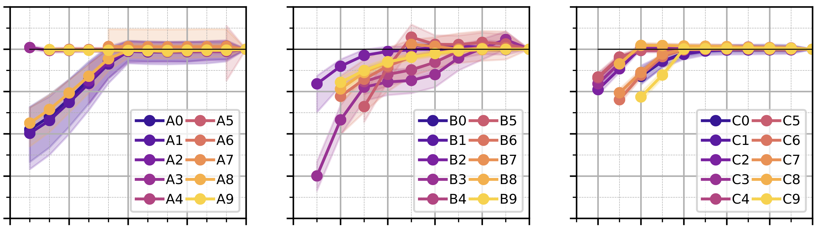
Wordline Voltage’s Effect on RowHammer
Mfr. A
Mfr. B
Mfr. C
1.2
1.0
0.8
0.6
0.4
0.2
3
Bit Error Rate
(Normalized to VPP=2.5V)
1.3 1.6 1.9 2.2 2.5
1.5 1.7 1.9 2.1 2.3 2.5
1.5 1.7 1.9 2.1 2.3 2.5
Wordline Voltage: VPP (V)
OBSERVATION 1
Fewer DRAM cells experience RowHammer bit flips under reduced wordline voltage
OBSERVATION 2
Reducing wordline voltage can cause more DRAM cells to experience bit flips in a small fraction of rows (15.4%)
Notes:
We make these observations for all three manufacturers

Slide 22
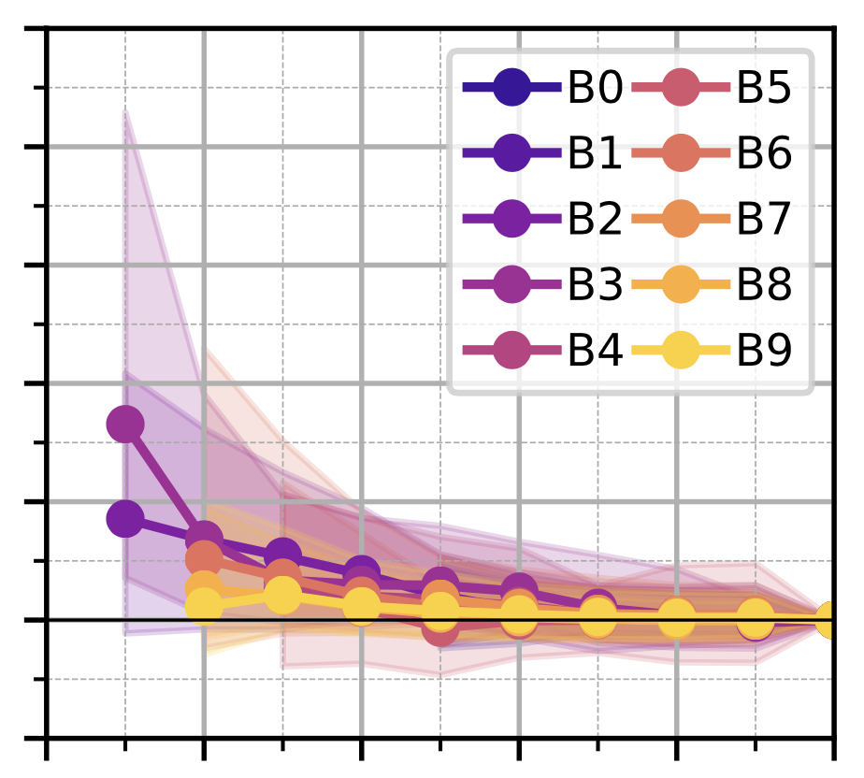
Wordline Voltage’s Effect on RowHammer
2.0
1.8
1.6
1.4
1.2
1.0
0.8
2.0
1.8
1.6
1.4
1.2
1.0
0.8
Different DRAM modules
Minimum Activation Count to Induce the First Bit Flip (Normalized to VPP=2.5V)
Minimum Activation Count to Induce the First Bit Flip
(Normalized to VPP=2.5V)
Higher is better
Variation across DRAM rows
Min. activation count
to induce the first bit flip
increases as VPP reduces
1.5 1.7 1.9 2.1 2.3 2.5
Wordline Voltage: VPP (V)
OBSERVATION 4
The first bit flip occurs at higher activation counts
as wordline voltage reduces
Notes:
This figure shows how [CLICK]
reducing wordline voltage [CLICK]
affects the minimum activation count needed to induce a RowHammer bit flip. Higher is better for robustness in this plot [CLICK]
Again, each curve represents a different DRAM module [CLICK]
and the shade around a curve shows the variation across DRAM rows [CLICK]
We observe that a RowHammer bit flip occurs at larger activation counts under reduced wordline voltage [CLICK]

Slide 23
Wordline Voltage’s Effect on RowHammer
2.0
1.8
1.6
1.4
1.2
1.0
0.8
Minimum Activation Count to Induce the First Bit Flip (Normalized to VPP=2.5V)
Higher is better
Min. activation count
to induce the first bit flip
reduces
1.5 1.7 1.9 2.1 2.3 2.5
Wordline Voltage: VPP (V)
OBSERVATION 5
For a small fraction of rows (14.2%), the first bit flip occurs at a smaller activation count as wordline voltage reduces
Notes:
We observe that bit flips can also occur at slightly lower activation counts for a small fraction of DRAM rows [CLICK]
Therefore, we conclude that reducing wordline voltage can worsen RowHammer vulnerability of a small fraction of rows [END]

Slide 24
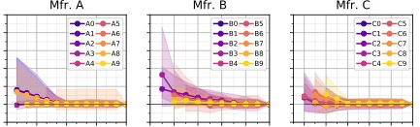
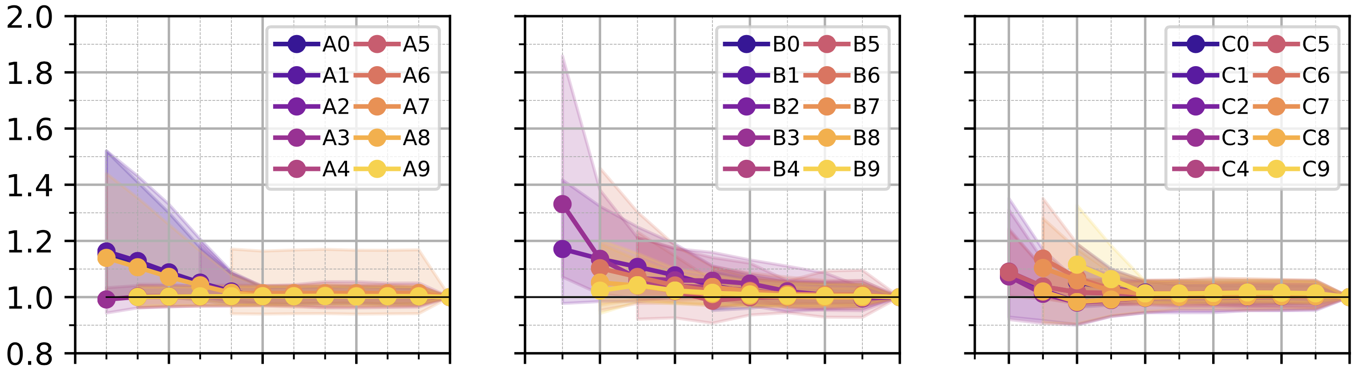
Wordline Voltage’s Effect on RowHammer
Mfr. A
Mfr. B
Mfr. C
2.0
1.8
1.6
1.4
1.2
1.0
0.8
Minimum Activation Count to Induce the First Bit Flip
(Normalized to VPP=2.5V)
1.3 1.6 1.9 2.2 2.5
1.5 1.7 1.9 2.1 2.3 2.5
1.5 1.7 1.9 2.1 2.3 2.5
Wordline Voltage: VPP (V)
OBSERVATION 4
The first bit flip occurs at higher activation counts
as wordline voltage reduces
OBSERVATION 5
For a small fraction of rows (14.2%), the first bit flip occurs at a smaller activation count as wordline voltage reduces
Notes:
These two observations apply to DRAM chips from all three manufacturers

Slide 25
Also in the Paper
Wordline voltage’s effect on RowHammer vulnerability
varies across different DRAM rows and manufacturers
OBSERVATION 3
Change in bit error rate varies across different DRAM rows and manufacturers
OBSERVATION 6
Change in the activation count at which the first bit flip occurs varies across different DRAM rows and manufacturers
Notes:
In the paper, we also show that wordline voltage’s effect on RowHammer vulnerability varies across different DRAM rows and across manufacturers in terms of [CLICK]
Bit error rate [CLICK]
And the minimum activation count that is needed to induce a bit flip [END]

Slide 26
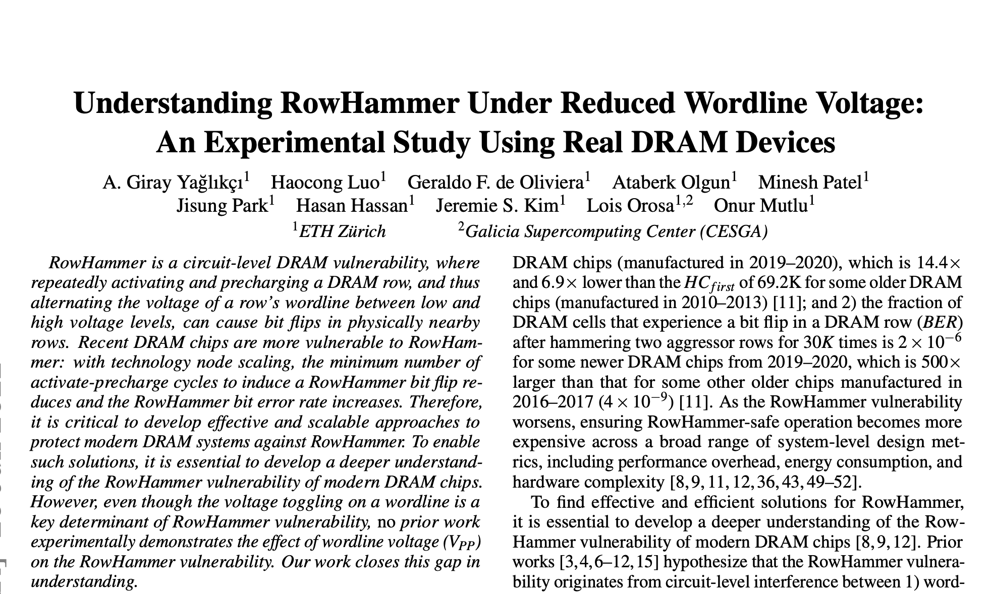
Also in the Paper
Wordline voltage’s effect on RowHammer vulnerability varies across different DRAM rows and manufacturers
OBSERVATION 3
BER reduction with reduced wordline voltage varies across different DRAM rows and manufacturers
OBSERVATION 6
HC_{first} increase with reduced wordline voltage varies across different DRAM rows and manufacturers
Full paper on arXiv: https://arxiv.org/abs/2206.09999
Notes:
Please refer to the full paper for more information about the distribution of RowHammer bit flips we observe

Slide 27
Key Takeaway from RowHammer Analysis
Takeaway 1
Reducing wordline voltage reduces RowHammer vulnerability
15.2% (66.9% max) fewer bit flips occur
Activation count at which the first bit flip occurs increases by 7.4% (85.8% max)
Notes:
We summarize our findings as scaling down wordline voltage leads to fewer DRAM cells to experience a RowHammer bit flip,
and bit flips to occur at larger hammer counts

Slide 28
Outline
Motivation and Goal
Motivation and Goal
Experimental Methodology
Temperature Analysis
Aggressor Row Active Time Analysis
Spatial Variation Analysis
Implications on Attacks and Defenses
Conclusions
Experimental Methodology
RowHammer Under Reduced Wordline Voltage
DRAM Operation Under Reduced Wordline Voltage
Conclusions
Notes:
Reducing

Slide 29
Our Hypothesis
Reducing wordline voltage
can reduce RowHammer vulnerability
without significantly affecting reliable DRAM operation
Wordline
Voltage
Wordline
Voltage
time
time
Aggressor Row
Aggressor Row
Victim Row
Reduction in Disturbance
Victim Row
Bitline
Bitline
Wordline
Wordline
Weaker Channel in Access Transistor
Strong Channel
Weaker Channel
Notes:
Until this point our we observe that reducing wordline voltage reduces RowHammer vulnerability [CLICK]
However, it can negatively affect DRAM row activation and refresh rate by causing a weaker channel in access transistors [CLICK]

Slide 30
Key Takeaways from DRAM Operation Analysis
Takeaway 2
208/272 tested DRAM chips reliably operate using nominal timing parameters due to the built-in safety margins (guardbands)
64/272 tested DRAM chips can reliably operate with longer row activation latency (24ns/15ns for 48/16 chips)
Takeaway 3
Takeaway 3
216/272 tested DRAM chips reliably operate using nominal refresh rate due to the built-in safety margins (guardbands)
56/272 tested DRAM chips can reliably operate using single-error-correction ECC or 2x the refresh rate for only 16.4% of rows
216/272 tested DRAM chips reliably operate using nominal refresh rate due to the built-in safety margins (guardbands)
56/272 tested DRAM chips can reliably operate using single-error-correction ECC or 2x the refresh rate for only 16.4% of rows
Notes:
This analysis provides two key takeaways: [CLICK]
First, More than 76% of the tested DRAM chips reliably operate using nominal timing parameters due to built-in safety margins, and remaining DRAM chips can still reliably operate with a longer row activation latency [CLICK]
Second, 80% of the tested DRAM chips can reliably operate using the nominal refresh rate, while the rest of them can still reliably work using single error correction code or double the refresh rate for a small fraction of DRAM rows [CLICK]
Now I will share our observations that suggest Takeaway 2 [CLICK]

Slide 31
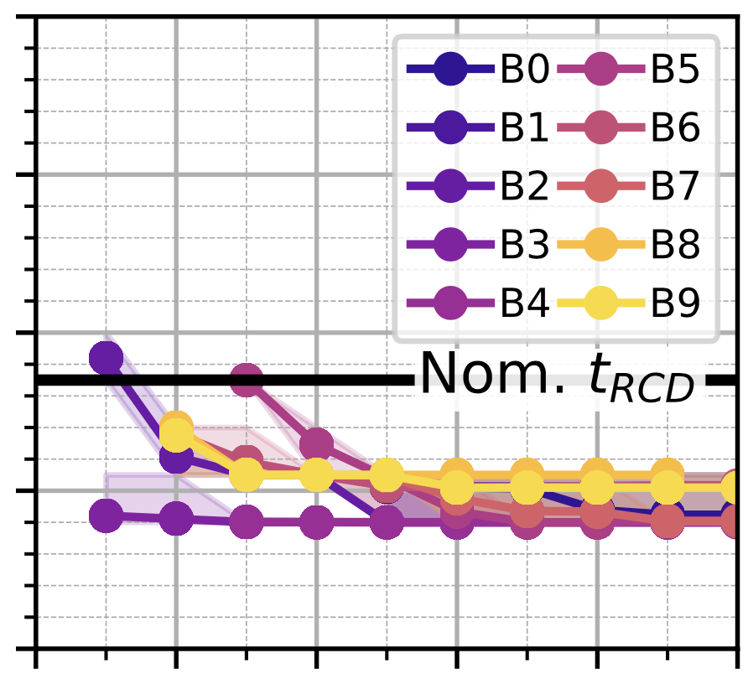
Wordline Voltage’s Effect on Row Activation Latency
25
20
15
10
5
Different DRAM modules
Row Activation
Latency (t_{RCD})
Nominal activation latency has a significant guardband
Row activation latency increases as V_{PP} reduces
Variation across DRAM rows
1.5 1.7 1.9 2.1 2.3 2.5
Wordline Voltage: VPP (V)
OBSERVATION 7
Row activation latency increases with reduced wordline voltage
208 out of 272 DRAM chips complete row activation before the nominal activation latency
Notes:
We begin with investigating wordline voltage's effect on row activation latency [CLICK]
This figure shows how [CLICK]
reducing wordline voltage [CLICK]
affects the row activation latency[CLICK]
We observe that the row activation latency increases with reduced wordline voltage [CLICK]
However, the nominal activation latency already has a significant guardband, [CLICK]
allowing most DRAM chips to complete row activation before the nominal activation latency [END]

Slide 32
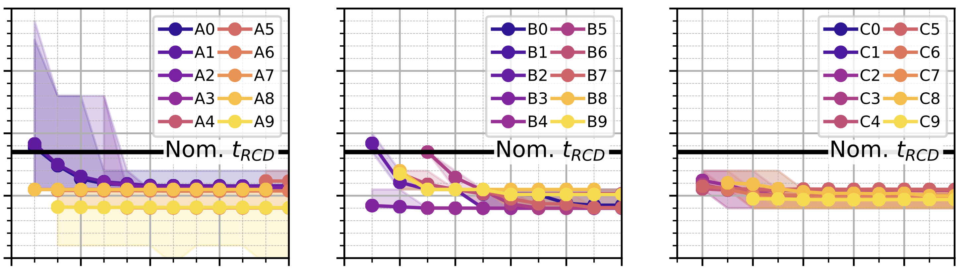
Wordline Voltage’s Effect on Row Activation Latency
Mfr. A
Mfr. B
Mfr. C
25
20
15
10
5
Row Activation
Latency (t_{RCD})
Nom. t_{RCD}
Nom. t_{RCD}
Nom. t_{RCD}
1.3 1.6 1.9 2.2 2.5
1.5 1.7 1.9 2.1 2.3 2.5
1.5 1.7 1.9 2.1 2.3 2.5
Wordline Voltage: VPP (V)
OBSERVATION 7
Row activation latency increases with reduced wordline voltage
208 out of 272 DRAM chips complete row activation before the nominal activation latency
Notes:
We observe across all three manufacturers that 208 out of 272 DRAM chips work reliably using the nominal activation latency

Slide 33
Wordline Voltage’s Effect on Row Activation Latency
Mfr. A
Mfr. B
Mfr. C
25
20
15
10
5
Row Activation
Latency (t_{RCD})
Nom. t_{RCD}
Nom. t_{RCD}
Nom. t_{RCD}
1.3 1.6 1.9 2.2 2.5
1.5 1.7 1.9 2.1 2.3 2.5
1.5 1.7 1.9 2.1 2.3 2.5
Wordline Voltage: VPP (V)
48 DRAM chips from Mfr A. reliably work with a row activation latency of 24 ns
16 DRAM chips from Mfr. B reliably work with a row activation latency of 15 ns
All DRAM chips from Mfr. C reliably work using the nominal latency of 13.5ns
Notes:
We have 64 DRAM chips that exhibit erroneous behavior. Among those, 48 from manufacturer A reliably work with a row activation latency of 24ns [CLICK]
the remaining 16 from Mfr B reliably works with a row activation latency of 15ns [CLICK]
All DRAM chips from Mfr C reliably works using the nominal row activation latency [CLICK]

Slide 34
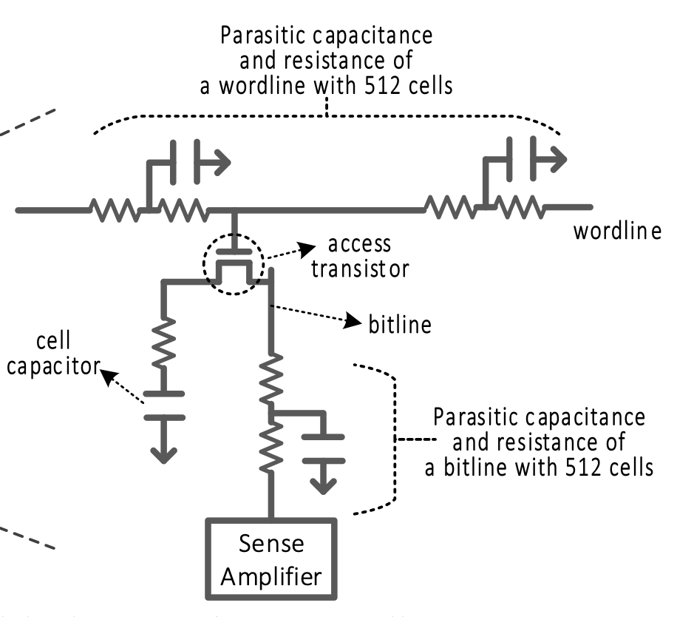
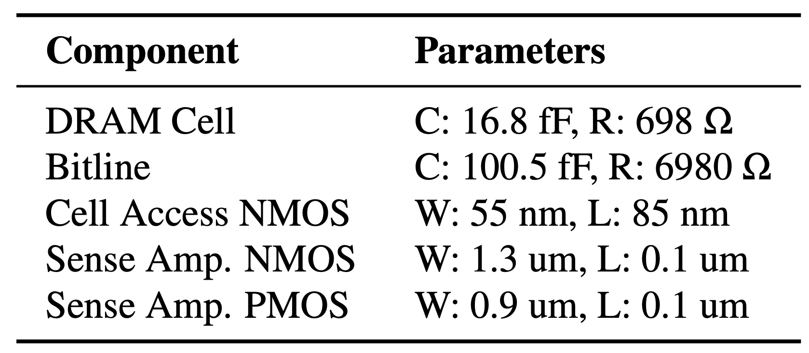
SPICE Simulation Methodology
Insights into wordline voltage’s affect on DRAM operation
22 nm transistor model
Monte-Carlo analysis with 5% variation and 10K iterations
Chang et al., "Understanding Reduced-Voltage Operation in Modern DRAM Devices: Experimental Characterization, Analysis, and Mechanisms," SIGMETRICS, 2018. [SPICE Model on GitHub]
Notes:
To provide more insights into our experimental observations we also conduct SPICE simulations [CLICK]
We use a 22 nm transistor model with the component parameters shown in this table [CLICK]
and we conduct Monte Carlo analysis with 5% variation and 10K iterations to account for manufacturing process variation [CLICK]

Slide 35
A Closer Look into Row Activation Latency
Bitline voltage takes longer to reach V_{TH}
Row activation completes when the bitline voltage reaches a threshold (V_{TH})
Reduced wordline voltage leads to a weaker channel in the access transistor
Reducing
Wordline
Voltage
Wordline
Access transistor
Bitline
Weaker
channel
Capacitor
OBSERVATION 8
Row activation latency increases
with reduced wordline voltage
Notes:
This is the waveform of the bitline voltage during a row activation. Different colors represent different levels of wordline voltage [CLICK]
Row activation completes when the bitline voltage reaches a threshold value [CLICK]
We observe that the row activation latency increases when wordline voltage is reduced from 2.5V (yellow) to 1.7V (purple) [CLICK]
To show why it happens, here we have a DRAM cell [CLICK]
When we reduce the wordline voltage, the voltage difference between the gate and the source of the access transistor gets lower, potentially leading to a weaker channel [CLICK]
Therefore, the row activation latency increases with reduced wordline voltage [CLICK]

Slide 36
Variation in Row Activation Latency
Worst case t_{RCDmin} when VPP = 2.5V
Worst case t_{RCDmin} when VPP = 1.9V
Nominal row activation latency
When wordline voltage is reduced from 2.5V to 1.9V:
The worst-case row activation latency is still lower than nominal value
The guardband reduces from 4.4% to 1.5% as the worst-case latency increases from 12.9ns to 13.3ns
OBSERVATION 9
SPICE simulation results agree with our observations based on experiments on real chips
The SPICE simulation results are not identical with real chip observations
because the SPICE model cannot simulate a real DRAM chip’s exact behavior without proprietary design and manufacturing information
Notes:
This is the probability density function of the row activation latency across different iterations of Monte Carlo analysis in our SPICE simulations. Different wordline voltages are color-coded. [CLICK]
We observe that the worst-case row activation latency is still lower than the nominal activation latency when the wordline voltage is larger than or equal to 1.9V [CLICK]
and voltage scaling reduces the available guardband [CLICK]
We observe that our experimental observations and SPICE simulation results agree with each other [CLICK]

Slide 37
Also in the Paper
Wordline voltage’s effect on DRAM charge restoration process
OBSERVATION 10
A DRAM cell’s capacitor voltage can saturate at a lower voltage level when wordline voltage is reduced
OBSERVATION 11
A DRAM cell’s charge restoration latency (t_{RASmin}) can increase with reduced wordline voltage
Notes:
In the paper, we also investigate the wordline voltage’s effect on DRAM charge restoration process [CLICK]
We observe that a DRAM cell’s capacitor voltage can saturate at a lower voltage level with reduced wordline voltage [CLICK]
And the latency of charge restoration can increase [END]

Slide 38
Also in the Paper
Wordline voltage’s effect on DRAM charge restoration process
OBSERVATION 10
A DRAM cell’s capacitor voltage can saturate at a lower voltage level when wordline voltage is reduced
OBSERVATION 11
A DRAM cell’s charge restoration latency (t_{RASmin}) can increase with reduced wordline voltage
Full paper on arXiv: https://arxiv.org/abs/2206.09999
Notes:
You can find these analyses in the full paper

Slide 39
Key Takeaways from DRAM Operation Analysis
Takeaway 2
208/272 tested DRAM chips reliably operate using nominal timing parameters due to the built-in safety margins (guardbands)
64/272 tested DRAM chips can reliably operate with longer row activation latency (24ns/15ns for 48/16 chips)
Takeaway 3
216/272 tested DRAM chips reliably operate using nominal refresh rate due to the built-in safety margins (guardbands)
56/272 tested DRAM chips can reliably operate using single-error-correction ECC or 2x the refresh rate for only 16.4% of rows
Notes:
This analysis provides two key takeaways: [CLICK]
First, More than 76% of the tested DRAM chips reliably operate using nominal timing parameters due to built-in safety margins, and remaining DRAM chips can still reliably operate with a longer row activation latency [CLICK]
Second, 80% of the tested DRAM chips can reliably operate using the nominal refresh rate, while the rest of them can still reliably work using single error correction code or double the refresh rate for a small fraction of DRAM rows [CLICK]
Now I will share our observations that suggest Takeaway 2 [CLICK]

Slide 40
Wordline Voltage’s Effect on DRAM Refresh
0.05
0.04
0.03
0.02
0.01
0
Different colors represent different wordline voltage levels
Data Retention
Bit Error Rate
Data retention BER increases
as wordline voltage reduces
64 256 1K 4K 16K
Refresh Window (ms)
OBSERVATION 12
More DRAM cells tend to experience data retention bit flips
when wordline voltage is reduced
OBSERVATION 13
216 out of 272 DRAM chips reliably operate using nominal refresh rate due to the built-in safety margins (guardbands)
Notes:
Next we investigate how wordline voltage affects DRAM refresh. This figure shows how [CLICK]
Retention bit errors occur for different wordline voltage levels[CLICK]
For different refresh windows [CLICK]
We observe that more DRAM cells tend to experience data retention bit flips when wordline voltage is reduced [CLICK]

Slide 41
Wordline Voltage’s Effect on DRAM Refresh
OBSERVATION 12
More DRAM cells tend to experience data retention bit flips
when wordline voltage is reduced
OBSERVATION 13
216 out of 272 DRAM chips reliably operate using nominal refresh rate due to the built-in safety margins (guardbands)
Notes:
For all three manufacturers, we observe that more DRAM cells tend to experience data retention bit flips under reduced wordline voltage [CLICK]
However, 216 out of 272 tested DRAM chips reliably operate using nominal refresh rate [CLICK]

Slide 42
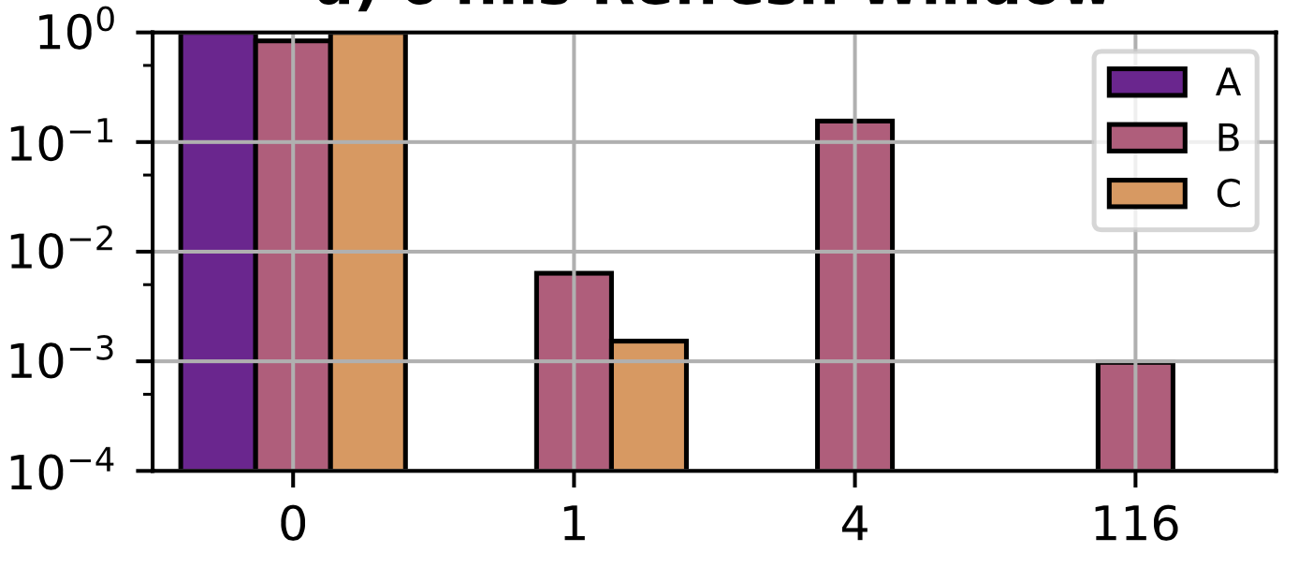
Spatial Distribution of Data Retention Bit Flips
There are no 64-bit words with more than one bit flip
A small fraction of DRAM rows contain erroneous words
OBSERVATION 14
Data retention errors can be avoided using single error correcting codes at the smallest refresh window that yields non-zero bit error rate
Fraction of DRAM Rows
Number of 64-bit data words with one bit flip
Notes:
Then, we focus on the spatial distribution of data retention bit flips at the SMALLEST refresh window with non-zero bit flips [CLICK]
We first observe that there are no 64-bit data words with more than one bit flip [CLICK]
Therefore, we conclude that data retention errors can be avoided using simple single error correcting codes [CLICK]
Then, we investigate the distribution of these erroneous data words across DRAM rows [CLICK]
The x-axis shows the number of 64-bit data words with one bit flip in a DRAM row [CLICK]
And the y-axis shows the fraction of DRAM rows in log-scale that contain those data words [CLICK]
From this plot, we conclude that only a small fraction of DRAM rows contain erroneous data words [CLICK]

Slide 43

Spatial Distribution of Data Retention Bit Flips
There are no 64-bit words with more than one bit flip
A small fraction of DRAM rows contain erroneous words
OBSERVATION 14
Data retention errors can be avoided using single error correcting codes at the smallest refresh window that yields non-zero bit error rate
OBSERVATION 15
Only a small fraction (16.4%/5.0%) of DRAM rows have erroneous words at the smallest refresh rate (64ms/128ms) that yields non-zero bit error rate
Notes:
We make the same observation for DRAM chips that observe the first data retention bit flips at 64ms and 128ms refresh windows [CLICK]

Slide 44
Key Takeaways from DRAM Operation Analysis
Takeaway 2
208/272 tested DRAM chips reliably operate using nominal timing parameters due to the built-in safety margins (guardbands)
64/272 tested DRAM chips can reliably operate with longer row activation latency (24ns/15ns for 48/16 chips)
Takeaway 3
216/272 tested DRAM chips reliably operate using nominal refresh rate due to the built-in safety margins (guardbands)
56/272 tested DRAM chips can reliably operate using single-error-correction ECC or 2x the refresh rate for only 16.4% of rows
Notes:
Based on these analyses, we add the third key takeaway:
Most of the DRAM chips reliably operate using nominal refresh rate, while the rest of them can still reliably operate using single error correction codes or doubling the refresh rate for a small fraction of rows

Slide 45
Outline
Motivation and Goal
Motivation and Goal
Experimental Methodology
Temperature Analysis
Aggressor Row Active Time Analysis
Spatial Variation Analysis
Implications on Attacks and Defenses
Conclusions
Experimental Methodology
RowHammer Under Reduced Wordline Voltage
DRAM Operation Under Reduced Wordline Voltage
Conclusions
Notes:
To summarize,

Slide 46
Conclusion
We provide the first RowHammer characterization under reduced wordline voltage
Experimental results with 272 real DRAM chips show that reducing wordline voltage:
Reduces RowHammer vulnerability
Bit error rate caused by a RowHammer attack reduces by 15.2% (66.9% max)
A row needs to be activated 7.4% more times (85.8% max) to induce the first bit flip
Increases row activation latency
More than 76% of the tested DRAM chips reliably operate using nominal timing parameters
Remaining 24% reliably operate with increased (up to 24ns) row activation latency
Reduces data retention time
80% of the tested DRAM chips reliably operate using nominal refresh rate
Remaining 20% reliably operate by
Using single error correcting codes
Doubling the refresh rate for a small fraction (16.4%) of DRAM rows
Reducing wordline voltage can reduce RowHammer vulnerability without significantly affecting reliable DRAM operation
Notes:
We provide the first RowHammer characterization using real DRAM chips under reduced wordline voltage [CLICK]
Our experimental results using 272 real DRAM chips show that with reduced wordline voltage, [CLICK]
RowHammer vulnerability reduces such that Bit flips occur at larger activation counts and fewer DRAM cells experience RowHammer bit flip [CLICK]
Reducing wordline voltage can increase row activation latency
However, more than 75% of the tested DRAM chips reliably operate using nominal timing parameters
And remaining 25% still reliably operate with increased row activation latency [CLICK]
Reducing wordline voltage can worsen data retention time
However, 80% of the tested DRAM chips reliably operate using nominal refresh rate
And remaining 20% experience bit flips that
can be corrected using single error correcting codes
or can be avoided by doubling the refresh rate for a small fraction (16.4%) of DRAM rows [CLICK]
Therefore we concluded that reducing wordline voltage can reduce RowHammer vulnerability without significantly affecting reliable DRAM operation [CLICK]

Slide 47
Understanding RowHammer Under Reduced Wordline Voltage An Experimental Study Using Real DRAM Devices
Abdullah Giray Yağlıkçı
Haocong Luo Geraldo F. de Oliviera Ataberk Olgun
Minesh Patel Jisung Park Hasan Hassan Jeremie S. Kim
Lois Orosa Onur Mutlu
Notes:
This is the end of my talk and now I am happy to answer your questions

Slide 48
Understanding RowHammer Under Reduced Wordline Voltage An Experimental Study Using Real DRAM Devices
Abdullah Giray Yağlıkçı
Haocong Luo Geraldo F. de Oliviera Ataberk Olgun
Minesh Patel Jisung Park Hasan Hassan Jeremie S. Kim
Lois Orosa Onur Mutlu
Notes:
This is the end of my talk and now I am happy to answer your questions

Slide 49
Understanding RowHammer Under Reduced Wordline Voltage An Experimental Study Using Real DRAM Devices
BACKUP SLIDES
Abdullah Giray Yağlıkçı
Haocong Luo Geraldo F. de Oliviera Ataberk Olgun
Minesh Patel Jisung Park Hasan Hassan Jeremie S. Kim
Lois Orosa Onur Mutlu
Notes:
BACKUP Slides

Slide 50
DRAM Operation
Bitline
1
Row Activation: Fetching the row’s content into the row buffer
DRAM Cell
Wordline
…
Column Access: Read/Write a column in the row buffer
DRAM Subarray
…
2
…
…
…
…
Precharge: Disconnect the row from the row buffer
3
Row Buffer
I/O Circuitry
Wordline
100%
Access transistor
V_{min}
Capacitor Voltage
DRAM Cell
charge
leakage
paths
Bitline
Capacitor
0%
REF
REF
REF
Time
Refresh Window
Notes:
This is a simplified diagram of a DRAM cell, where the data is stored as capacitor voltage and accessed through the access transistor [CLICK]
Inherently exhibiting several charge leakage paths [CLICK]
And requiring to perform refresh operations with a time period called refresh window
This cartoon demonstrates how a DRAM cell is accessed [CLICK]
In order to access data from a DRAM row, the memory controller must first open or activate the row [CLICK]
The READ and WRITE requests targeting the row are serviced from the row buffer [CLICK]
After all requests are serviced from the row, the memory controller must close or precharge the row [CLICK] in order to begin accessing data from another row.

Slide 51
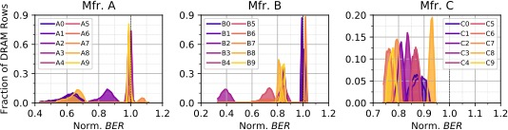
Distribution of Bit Flips across DRAM Rows
Across rows
Across manufacturers
OBSERVATION 3
BER reduction with reduced wordline voltage varies across different DRAM rows and manufacturers
Notes:
Please refer to the full paper for more information about the distribution of RowHammer bit flips we observe

Slide 52
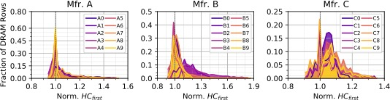
Distribution of HC_{first} across DRAM Rows
Across rows
Across manufacturers
OBSERVATION 3
HC_{first} reduction with reduced wordline voltage varies across different DRAM rows and manufacturers
Notes:
Please refer to the full paper for more information about the distribution of RowHammer bit flips we observe

Slide 53
Wordline Voltage’s Effect on DRAM Refresh
0.32
0.24
0.16
0.08
0
Probability Density
0 0.5% 1.0% 1.5%
Data Retention Bit Error Rate
OBSERVATION 12
More DRAM cells tend to experience data retention bit flips
when wordline voltage is reduced
Notes:
This figure shows how [CLICK]
reducing wordline voltage [CLICK]
affects the minimum hammer count needed to induce a RowHammer bit flip [CLICK]
We observe that fewer DRAM cells experience RowHammer bit flips under reduced wordline voltage [CLICK]

Slide 54
Wordline Voltage’s Effect on DRAM Refresh
OBSERVATION 12
More DRAM cells tend to experience data retention bit flips
when wordline voltage is reduced
Notes:
This figure shows how [CLICK]
reducing wordline voltage [CLICK]
affects the minimum hammer count needed to induce a RowHammer bit flip [CLICK]
We observe that fewer DRAM cells experience RowHammer bit flips under reduced wordline voltage [CLICK]

Slide 55
Charge Restoration Process
OBSERVATION 10
A DRAM cell’s capacitor voltage can saturate at a lower voltage level when wordline voltage is reduced
Notes:
You can find these analyses in the full paper

Slide 56
Also in the Paper
OBSERVATION 11
A DRAM cell’s charge restoration latency (t_{RASmin}) can increase with reduced wordline voltage
Notes:
You can find these analyses in the full paper

Slide 57
DRAM Chips Tested
Notes:
Please refer to our full paper for more detailed information about our tested chips

Slide 58
RowHammer Test

Slide 59
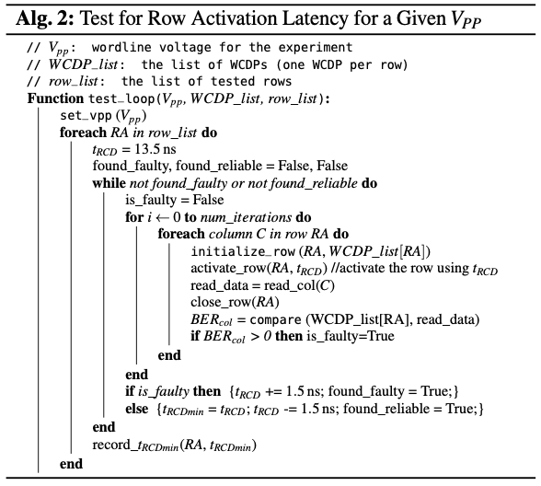
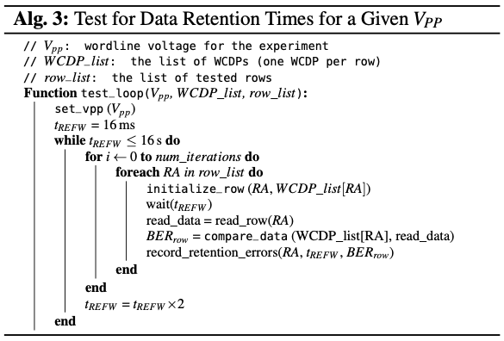
Row Activation and Refresh Rate Tests

Slide 60
Understanding RowHammer Under Reduced Wordline Voltage An Experimental Study Using Real DRAM Devices
BACKUP SLIDES
Abdullah Giray Yağlıkçı
Haocong Luo Geraldo F. de Oliviera Ataberk Olgun
Minesh Patel Jisung Park Hasan Hassan Jeremie S. Kim
Lois Orosa Onur Mutlu
Notes:
BACKUP Slides

